Slide 1
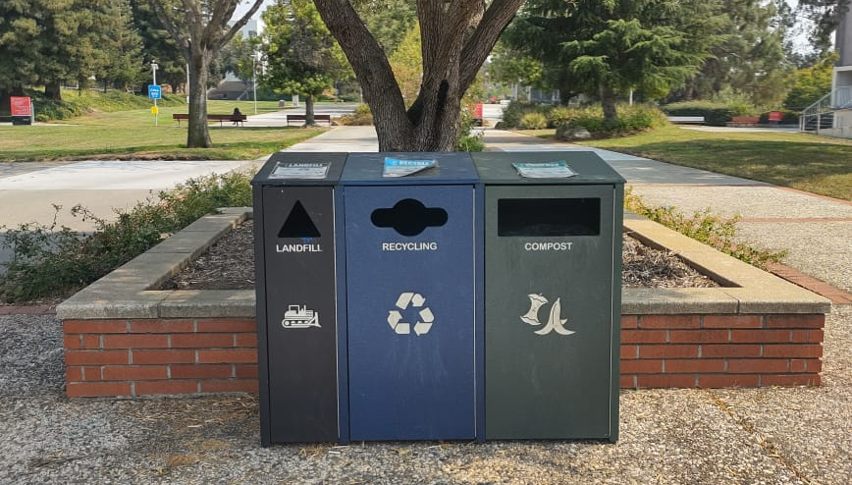
How many times have you come across this right here on the campus and just passed by?

Slide 2


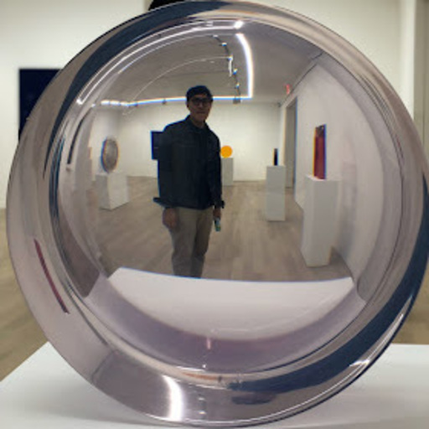
Our Team
Ayushi
Gabi
Jim

Slide 3
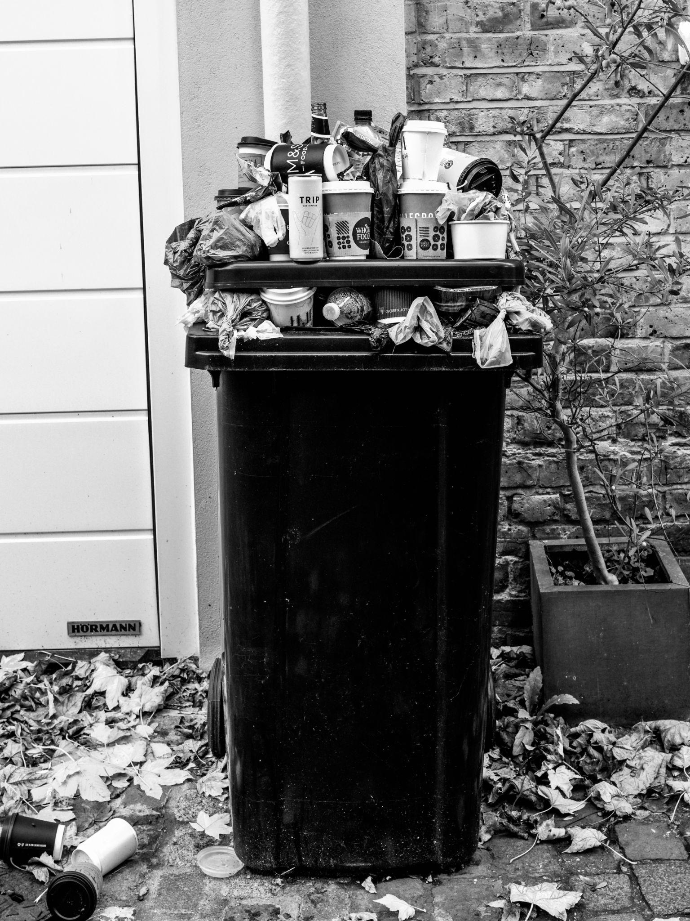
Despite billions of dollars spent on recycling
The U.S. recycles less than 22% of its trash.

Slide 4
The Problem
Even though the standardized labels are proven to increase recycling levels up to
People still tend to avoid recycling due to confusion when it comes to choosing the right trash bin for each component.
500%

Slide 5
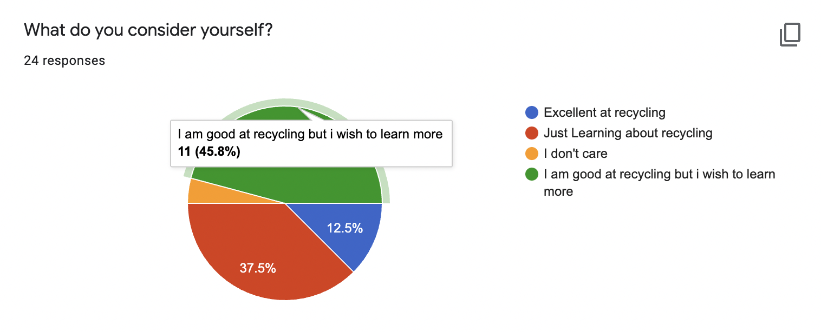
The Process
U S E R S U R V E Y
45.8% of the survey respondents think they are good at recycling but they wish to learn more about it and 37.5% think they are just learning about it. Only 12% of them considered themselves excellent at recycling.
On asking if they would change there if they knew better, 91.7% of them responded yes.
About using such an application from their phone that teaches them to recycle, 66.7% said yes and 25% maybe.
Users would like to have some incentive to use the application like every time they recycle and they get points.
https://drive.google.com/file/d/1bkXcv3vZvyYrm5JZ6yMDYlJlYbpbtCk4/view?usp=sharing

Slide 6
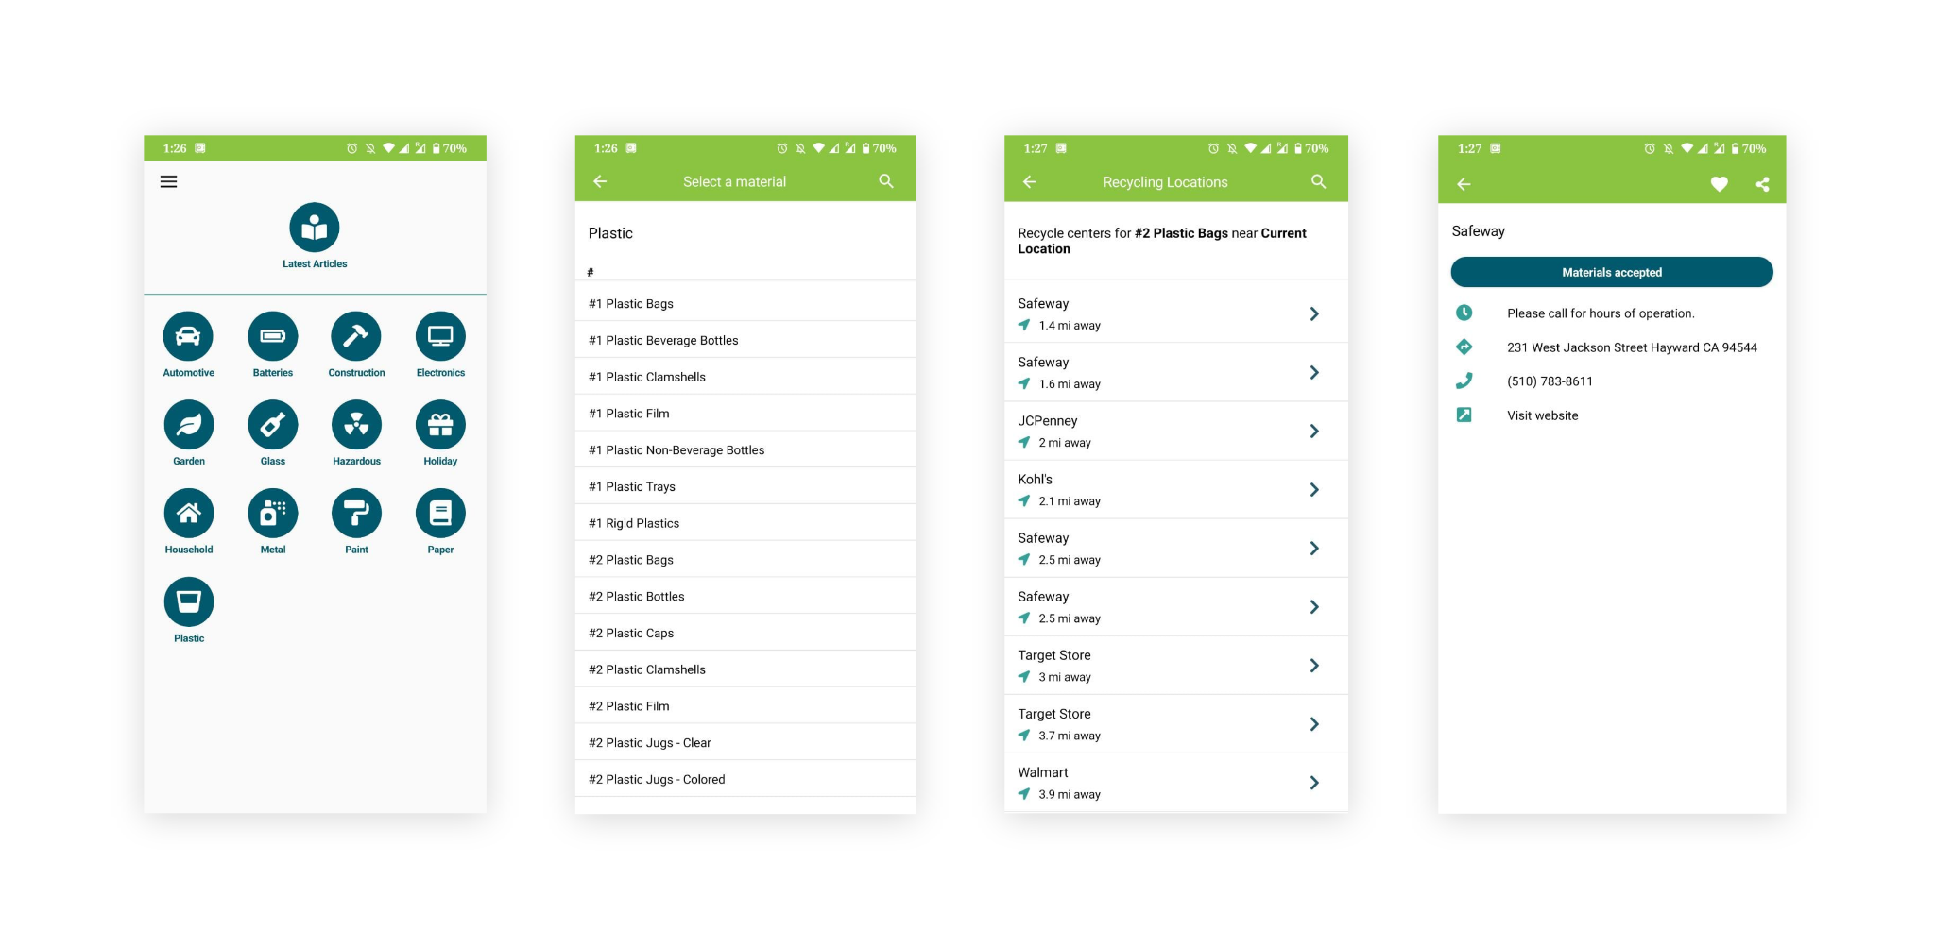
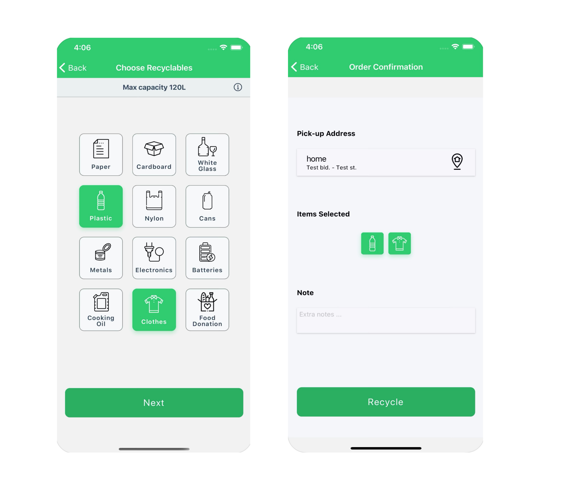
The Prior Art
1.
2.

Slide 7
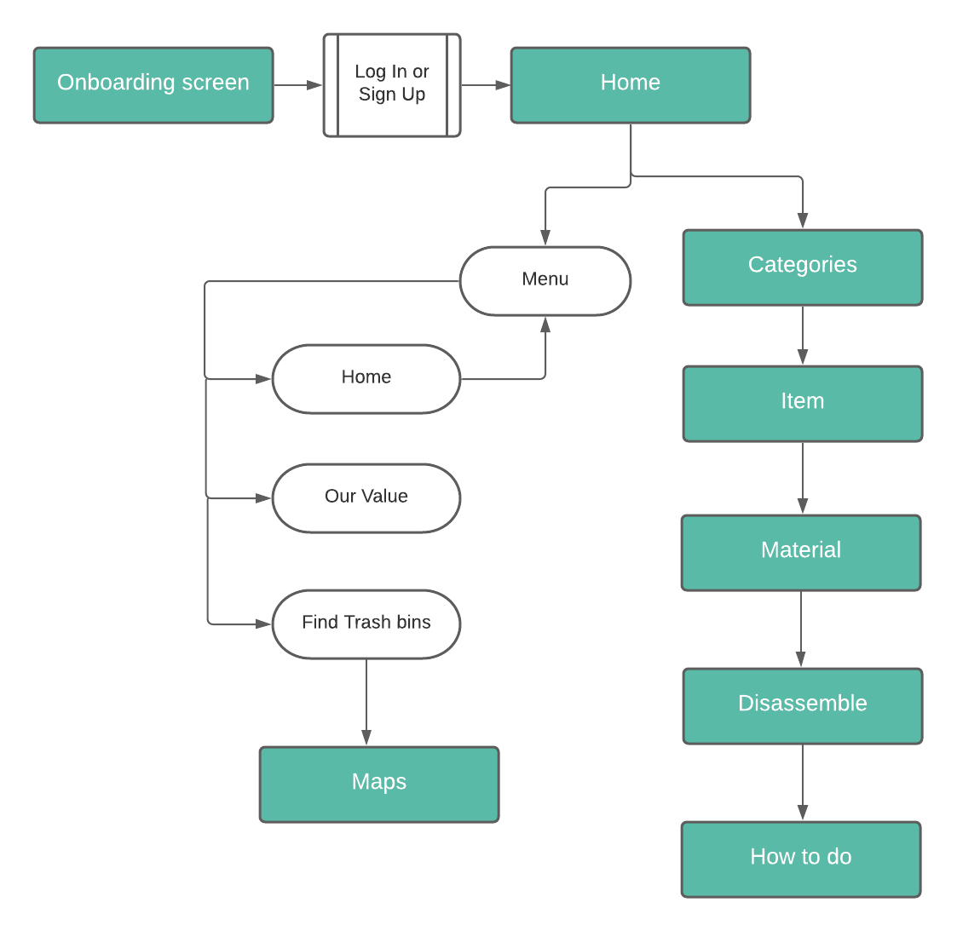
The Process
I N F O R M A T I O N A R C H I T E C T U R E
Design Thinking helped us better understand user’s needs and develop a solution to how people view recycling. After empathizing with people who often get confused when it is time to separate their trash, we developed on the idea of an easy flow to help identify materials and educate on disposal of several common disposed items.

Slide 8


Slide 9
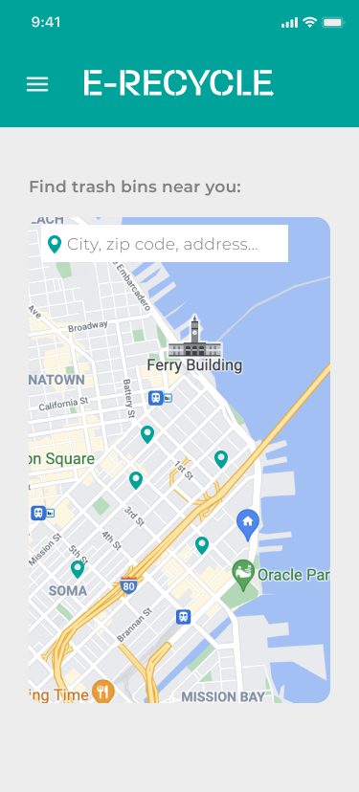


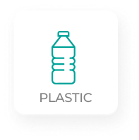

The Solution
E-Recycle delivers easy understanding of recycling bins.

Slide 10
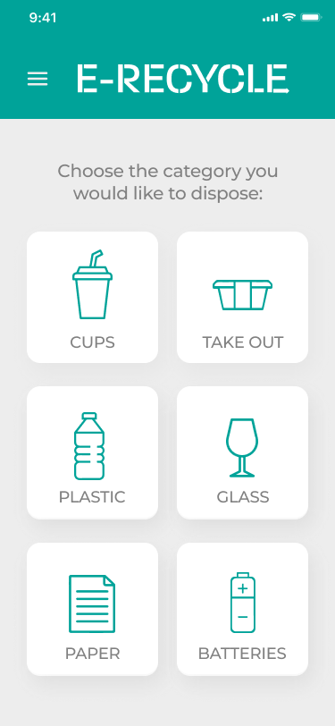
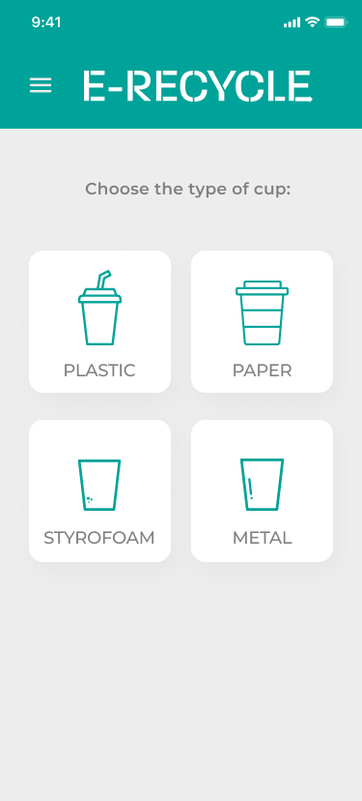
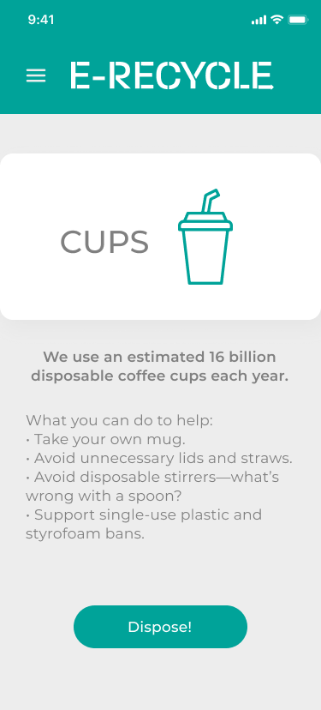
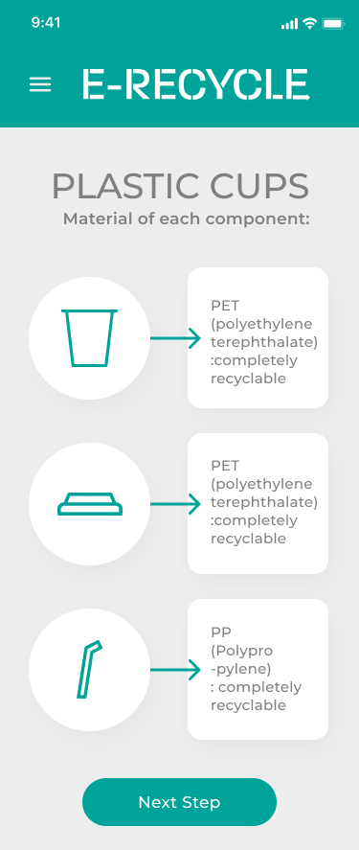
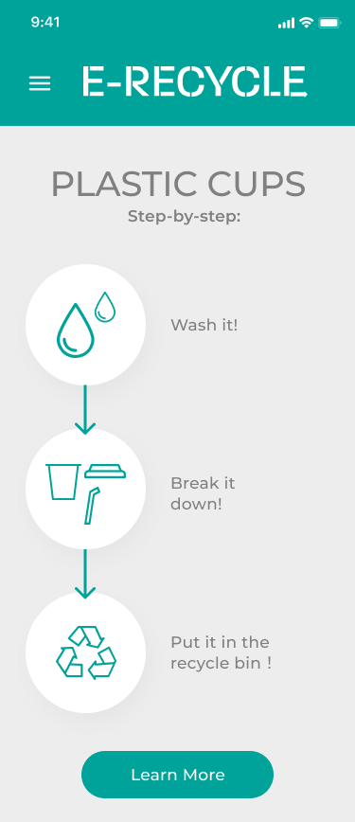
The Solution
W I R E F R A M E S

Slide 11
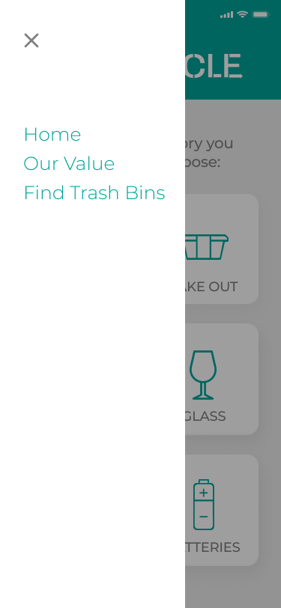
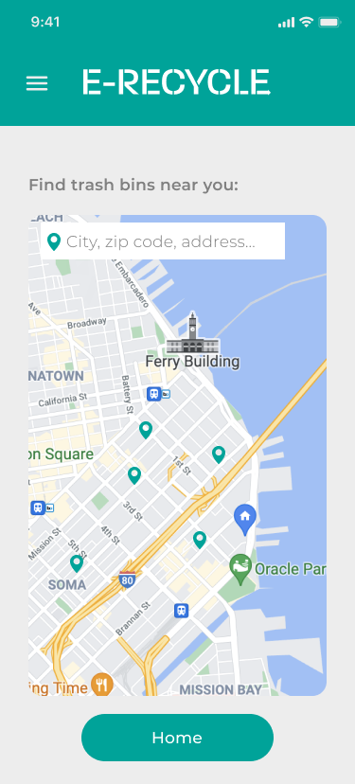
The Solution
W I R E F R A M E S
https://overmochi.github.io/e-recyle.github.io/

Slide 12

Next Steps
F U T U R E S C O P E
If we had more time to think through we could also have included various other items that could help users to learn more about recycling,
there could be blogs and the latest government policies and news around recycling in the area.
A scanner could also be included that scans the label on the packaging to tell you enough information about the recycling of the material.
There could also be a purchase section where people could easily purchase the recycled items and reuse too.
A scope of adding some incentive around using the application could be a good idea.

Slide 13
Everyday is EARTH day.
Q U E S T I O N S ?

